Slide 1
Arduino
Development Board
Course Number : TTH2D3
CLO : 1
Week : 5-7
CLO#1 Student have the knowledge to explain microprocessor system
[C2] Understand the history of microprocessor and microcontroller
[C2] Understand the architecture of computer system
[C2] Understand the design of minimum system for microcontroller

Slide 2
What is the difference between μP, μC, and Development Board?
development board
microcontroller
External Memory
Pin Connector
microprocessor
memory
CU
Register
Flash
SRAM
EEPROM
ALU
Programmable
Input / Output
Power
Regulator
Programmable
Timer / Counter
Programmable
Interrupt Controller
(Crystal) Clock
Regulator

Slide 3
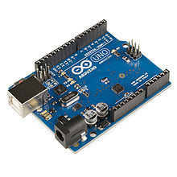

Arduino
Development Board

Slide 4
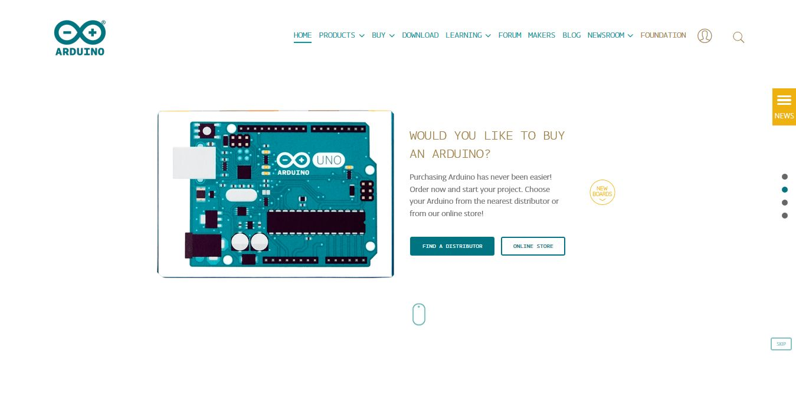
Arduino: Resources
http://www.arduino.cc
http://www.arduino.org/products/boards/arduino-uno

Slide 5
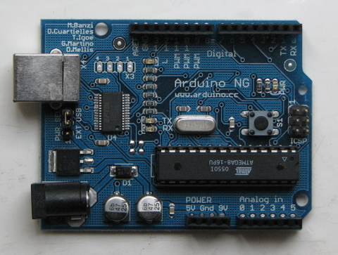
What is Arduino?
Physical computing platform
Open source
“Hardware Abstracted” Wiring Language
USB programmable
Large community
Inexpensive ($31.95 from Sparkfun)

Slide 6
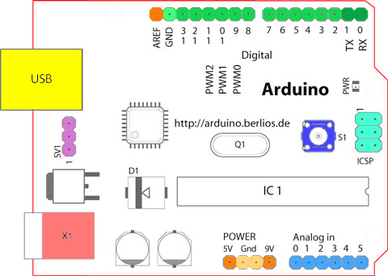
Arduino Board Overview

Slide 7
Arduino Official
Arduino boards
Uno
Mega 2560
Mega ADK
Ethernet
BT
LilyPad
Fio
Pro
Nano
Mini
Pro Mini
Arduino shields
Ethernet
Wireless SD
Wireless Proto
Motor
Proto

Slide 8
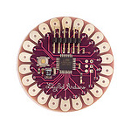
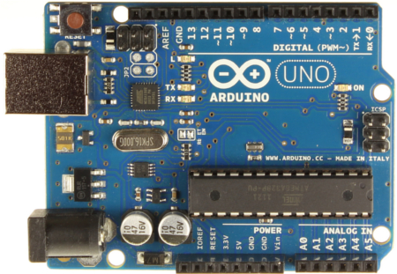
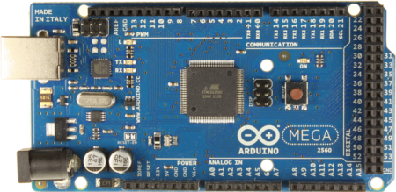
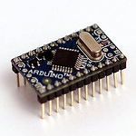
Arduino Boards

Slide 9
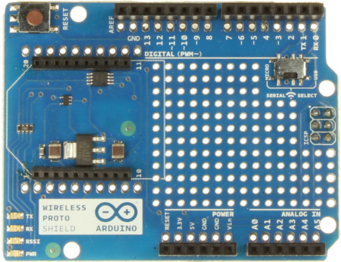
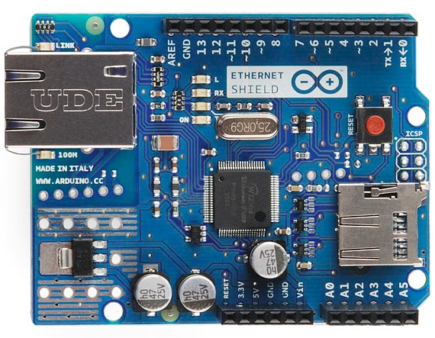
Arduino Shields

Slide 10
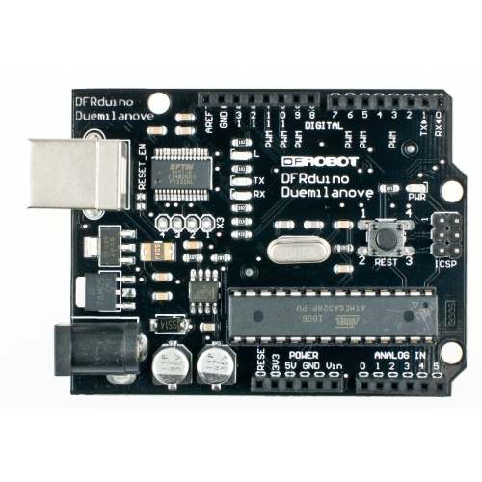
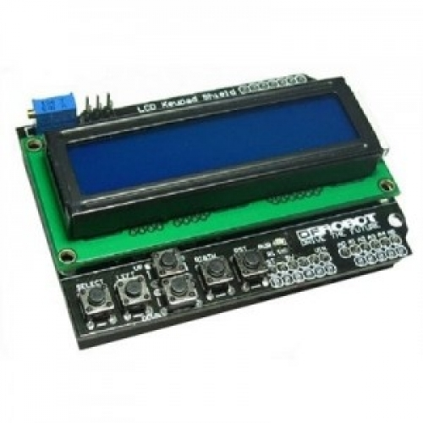
“Unofficial” Boards and Shields
Adafruit
Sparkfun
DFRobot
Itead Studio
etc

Slide 11
Arduino Uno: Physical Layout

Slide 12
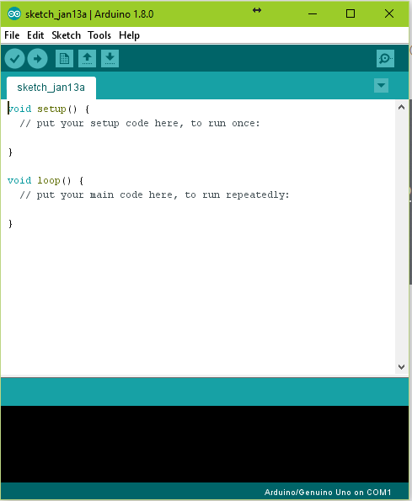
Arduino IDE: Integrated Development Environment
Arduino programming language based on Wiring (http://wiring.org.co)
Arduino development environment based on Processing (http://www.processing.org)
Source code = Sketches

Slide 13
“Official”
Arduino playground
http://playground.arduino.cc/
Learning Arduino
https://www.arduino.cc/en/Guide/HomePage

Slide 14
See you on next class

